Slide 1
BATTLE OF ALGIERS

Slide 2
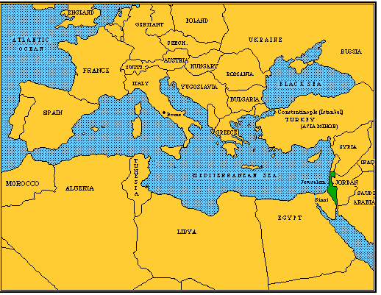

Slide 3
After WWII Algeria became the battleground for the most violent process of decolonization in North Africa and in the Middle East
Algeria was by 1945 home to one million French settlers and 8 million Algerians and the French claimed this colony as an integral part of France itself

Slide 4
The settler community was against integration that might threaten its political dominance and economic privilege
French education made the Algerian elite sensitive to the gap between European liberal ideas and the colonial reality

Slide 5
At the end of WWII the French put down several demonstrations and killed 20000 to 40000 Algerians
Creation of FLN
(Front de Liberation National = National Liberation Front)

Slide 6
The Vietnamese victory against the French in 1954 at Dien Bien Phu demonstrated that armed resistance was a viable liberation strategy
FLN organized guerilla warfare
The French deployed 400000 soldiers in order to crush the revolt

Slide 7
Long and bloody war
The French responded to FLN’s actions with counter-terrorist strategies and successfully contained the FLN threat
Stalemate. French brutality provoked international condemnation of French policy
In 1962 Algeria gained independence

